Slide 1

Note: The data and information in this document is reflective of a hypothetical situation and client. This document is to be used for KPMG Virtual Internship purposes only.
Sprocket Central Pty Ltd
Data analytics approach
[Division Name] - [Engagement Manager], [Senior Consultant], [Junior Consultant]

Slide 2
Note: The data and information in this document is reflective of a hypothetical situation and client. This document is to be used for KPMG Virtual Internship purposes only.
Agenda
Introduction
Data Exploration
Model Development
Interpretation

Slide 3
Note: The data and information in this document is reflective of a hypothetical situation and client. This document is to be used for KPMG Virtual Internship purposes only.
Introduction
Analysis of existing and new customers
Customers’ Age Distributions
Statistics of purchased bikes in the last 3 years
Job Industry category
Customers’ Wealth Segments
Number of Customers’ that owns a car

Slide 4
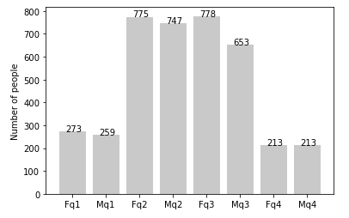
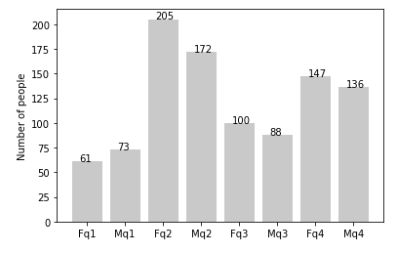
Note: The data and information in this document is reflective of a hypothetical situation and client. This document is to be used for KPMG Virtual Internship purposes only.
Data Exploration
old
Customers’ Age Distribution
According to the bar chart, most of our new customers are between 25 to 48 years old.
There’s a huge drop on the percentage of customers from 48 to 59 years old.
There is a slight increase in the number of customers over 59 years old in terms of percentage.
There is not much changes in the percentage of those under 25 years old.
new

Slide 5
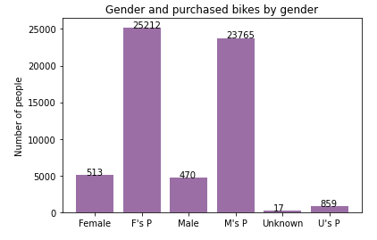
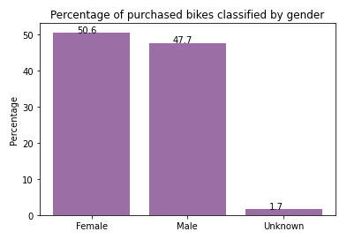
Note: The data and information in this document is reflective of a hypothetical situation and client. This document is to be used for KPMG Virtual Internship purposes only.
Model Development
Statistics of Purchased Bikes in the last 3 years
new
According to the bar chart, our new customers are mostly female with 50.6% of bike purchases (total of 25,212 bikes)
Male customers have 47.7% of bike purchases (total of 23,765 bikes)
This means that female customers are more likely to purchase bikes compared to male customers.
new

Slide 6
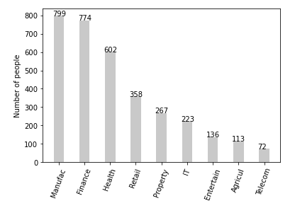
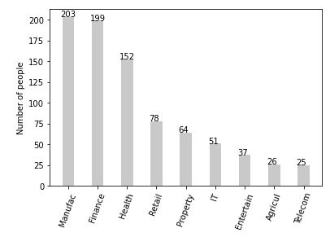
Note: The data and information in this document is reflective of a hypothetical situation and client. This document is to be used for KPMG Virtual Internship purposes only.
Interpretation
Job Industry Category
old
Most of our existing customers are from the Manufacturing and Financial Services industry.
Most of our new customers are also from the Manufacturing and Financial Services industry.
The pattern of the other industries are both (existing and new) are the same.
new

Slide 7
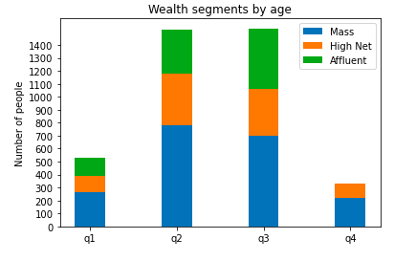
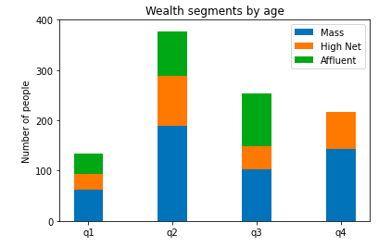
Note: The data and information in this document is reflective of a hypothetical situation and client. This document is to be used for KPMG Virtual Internship purposes only.
Interpretation
Customers’ Wealth Segments
old
Mass Customer has the highest number across all of the ages. This shows that we should focus more on this social class.
High Net Customer has the second highest number across all ages.
For Affluent Customers, it is mostly the second and third quadrant that has a high number of customers.
new

Slide 8
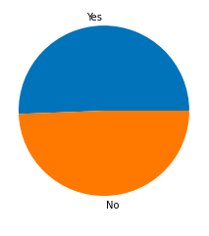
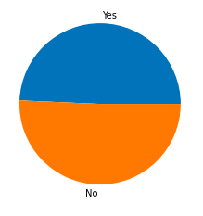
Note: The data and information in this document is reflective of a hypothetical situation and client. This document is to be used for KPMG Virtual Internship purposes only.
Interpretation
Number of Customers’ that owns a car
old
2024 of our existing customers owns a car while 1976 does not own a car.
493 of our new customers owns a car while 507 does not own a car.
new

Slide 9
Note: The data and information in this document is reflective of a hypothetical situation and client. This document is to be used for KPMG Virtual Internship purposes only.
Appendix

Slide 10
Note: The data and information in this document is reflective of a hypothetical situation and client. This document is to be used for KPMG Virtual Internship purposes only.
Appendix
This is an optional slide where you may place any supporting items.

